Slide 1
Software Design and Analysis
Implementation Models: Component diagram,
Package Diagram, Deployment Diagram
Department of Computer Science,
FAST-NUCES, CFD Campus

Slide 2
Lecture Material
System Analysis and Design in a Changing World (Chapter 6, 13)

Slide 3
Lecture Outline
Implementation Models
  Component Diagram
  Package Diagram
  Deployment Diagram

Slide 4
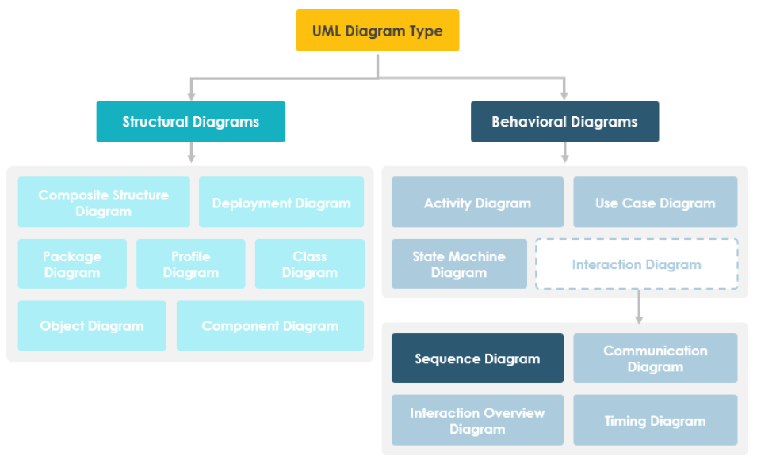
Behavioral Models

Slide 5
Structured Approach--Component Diagrams
Shows a set of components and their relationships.
Represents the static implementation view of a system.
  Serve as a transition from design to implementation.
Components map to one or more classes, interfaces, or collaborations.
Can relates to architecture diagram, how?
loanOfficer.dll
component
Registrar.exe
LoanOfficer
CreditSearch
Course.dll
LoanPolicy
Student.dll
classes

Slide 6
Component Diagrams
Modular unit with well-defined interfaces that is replaceable within its environment.
Autonomous unit within a system.
Has one or more provided and required interfaces.
Its internals are hidden and inaccessible.
A component is encapsulated
  Its dependencies are designed such that it can be treated as independently as possible.

Slide 7

Component Diagrams -- Notation
A component is shown as a rectangle with:
  A keyword/stereotype <<component>>
    there are a number of standard stereotypes ex: <<entity>>, <<subsystem>>, <<document>>, <<file>>
  Optionally, in the right hand corner a component icon can be displayed
  A component icon is a rectangle with two smaller rectangles jutting out from the left-hand side

Slide 8
Component Elements
A component can have
  Interfaces
    An interface represents a declaration of a set of
    operations and obligations
  Usage dependencies
    A usage dependency is relationship which one element
    requires another element for its full implementation
  Ports
    Port represents an interaction point between a component
    and its environment
  Connectors
    Connect two components
    Connect the external contract of a component to the internal structure

Slide 9
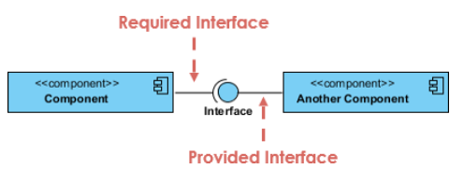
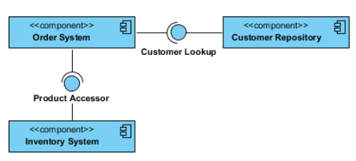
Component Diagrams -- Notation
A component can have:
  Interfaces: An interface represents a declaration of a set of operations and obligations.

Slide 10
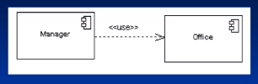
Component Diagrams
A component can have:
  Usage dependencies: A usage dependency is relationship in which one element requires another element for its full implementation.
  Is a dependency in which the client requires the presence of the supplier
  Is shown as dashed arrow with a <<use>> keyword
  The arrowhead point from the dependent component to the one of which it is dependent

Slide 11

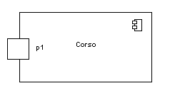
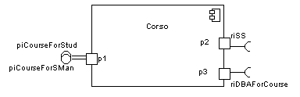
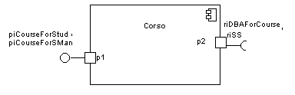
Component Diagrams
A component can have:
  Ports: Port represents an interaction point between a component and its environment.
    Also, Between that component and its internal parts
Is shown as a small square symbol
Ports can be named, and the name is placed near the square symbol
Is associated with the interfaces that specify the nature of the interactions that may occur over a port

Slide 12
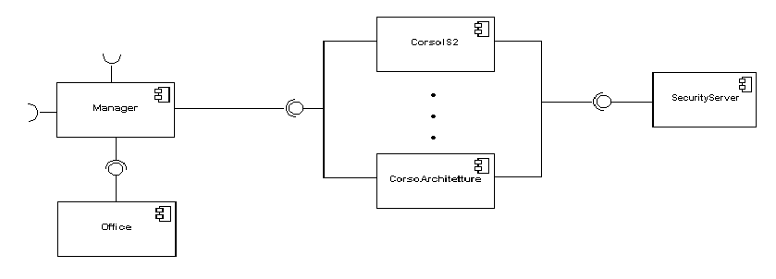
Component Diagrams
A component can have:
  Connectors: Connect two components
  1. Assembly Connector
  A connector between 2 components defines that one component provides the services that another component requires
    Must only be defined from a required interface to a provided interface
  Multiple connections directed from a single required interface to provided interfaces indicates that the instance that will handle the signal will be determined at execution time

Slide 13
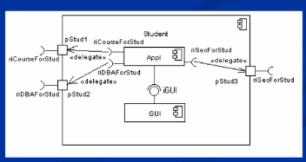
Component Diagrams
A component can have:
  Connectors: Connect two components
  2. Delegate connectors
  Links the external contract of the component to the internal realization
  Represents the forwarding of signals
  It must only be defined between used interfaces or ports of the same kind

Slide 14
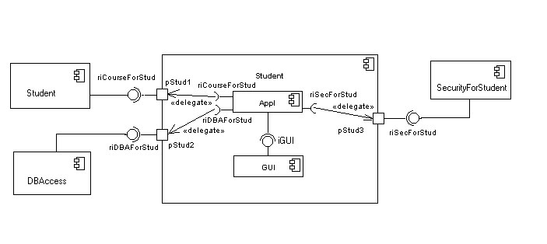


Slide 15
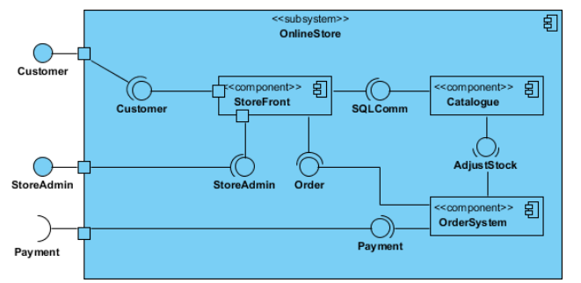
Component Diagrams -- Notation

Slide 16
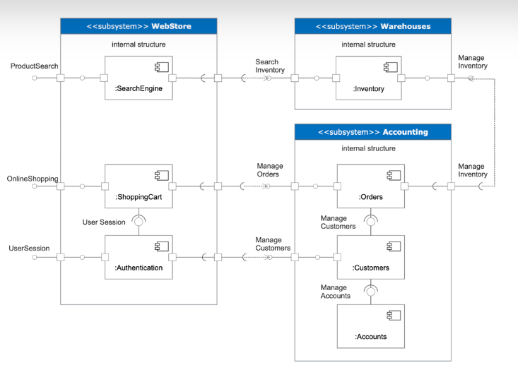
Component Diagrams -- Example

Slide 17
Package Diagram
Package Diagram can be used to simplify complex class diagrams, it can group classes into packages.
A package is a collection of logically related UML elements.
It usually designed as bottom-up approach.

Slide 18
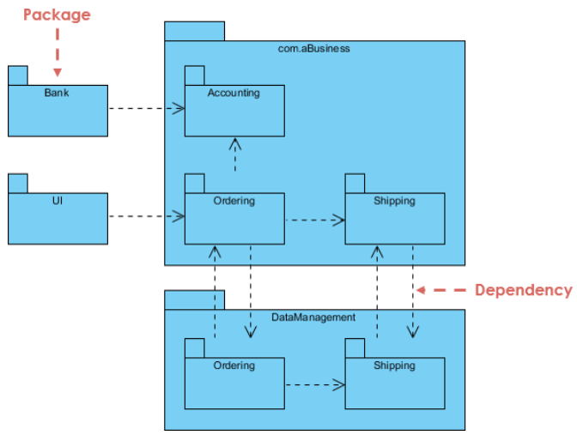
Package Diagram

Slide 19
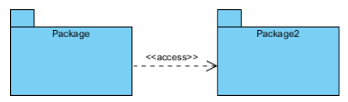
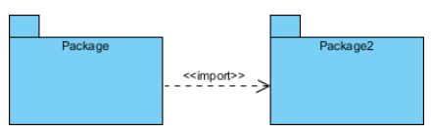
Package Diagram

Slide 20
Deployment Diagram
Shows a set of processing nodes and their relationships.
Represents the static deployment view of an architecture.
Nodes typically enclose one or more components.
They capture the hardware that will be used to implement the system and the links between different items of hardware.
They model physical hardware elements and the communication paths between them
They are also useful for Document the deployment of software components or nodes.

Slide 21
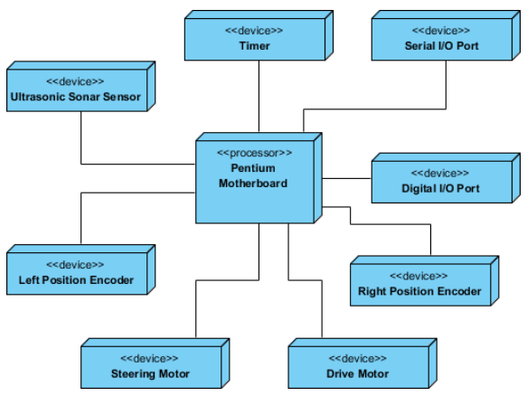
Deployment Diagram

Slide 22
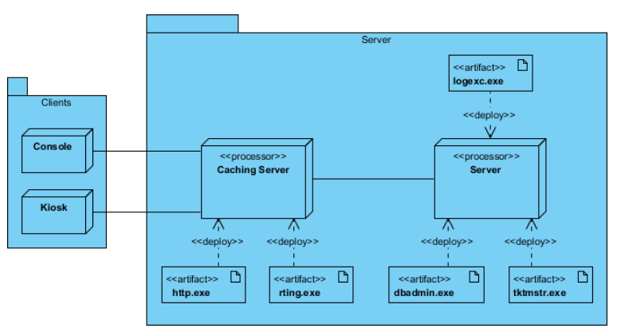
Deployment Diagram

Slide 23
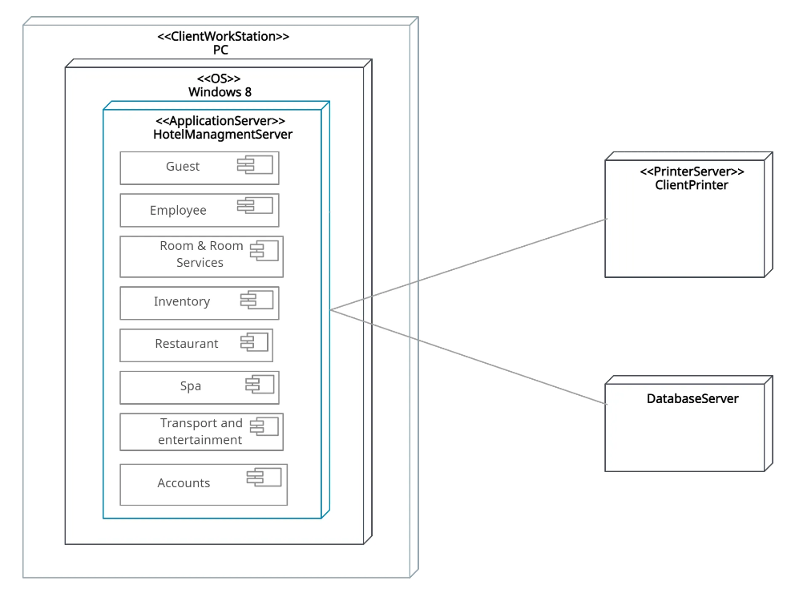
Deployment Diagram

